Slide 1


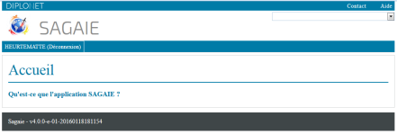
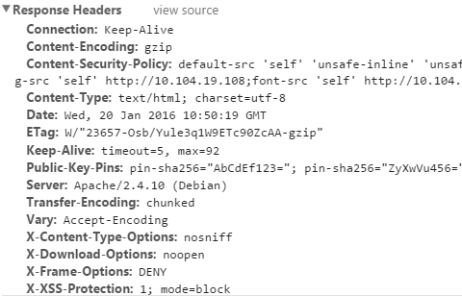
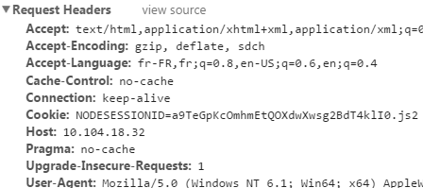






https://elise.diplomatie.gouv.fr/sagaie
HTTPS://
1
14
Load balancing F5
2
13
10
5
elise.diplomatie.gouv.fr
backend.diplomatie.gouv.fr
Load balancing Apache
Load balancing Apache
BalancerMember http://x.x.x.x:8888 route=js1 retry=30 keepalive=on ttl=10 loadfactor=3 flushpackets=auto timeout=300
4
11
BalancerMember http://x.x.x.x:8081 retry=30 keepalive=on ttl=10 loadfactor=3 flushpackets=auto timeout=300
http://backend.diplomatie.gouv.fr/sagaiebackend
12
6
9
3
Backend
Backend
System
Tomcat-1
System
Tomcat-1
sagaiebackend.war
sagaiebackend.war
System
Sagaie-1-
System
Sagaie-1-
Tomcat-2
Tomcat-3
Tomcat-2
Tomcat-3
Sagaie-2-
Sagaie-3-
Sagaie-2-
Sagaie-3-
sagaiebackend.war
sagaiebackend.war
sagaiebackend.war
sagaiebackend.war
Quad Core - 4Go RAM
8
Quad Core - 4Go RAM
Quad Core - 4Go RAM
Quad Core - 4Go RAM
7
{Instance} Tomcat
{Nœud} Applicatif Sagaie
{Nœud} Applicatif Sagaie
Actif
Passif

Slide 2



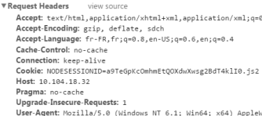


https://elise.diplomatie.gouv.fr/sagaie
1
10
HTTPS://
2
Load balancing F5
9
Load balancing Apache
3
8
System
app-1-
System
app-1-
{Nœud} Applicatif
app-2-
app-3-
app-2-
app-3-
Quad Core - 4Go RAM
Quad Core - 4Go RAM
Load balancing HAProxy
4
6
Backend
Backend
System
Tomcat-1
System
Tomcat-1
{Instance} Tomcat
sagaiebackend.war
sagaiebackend.war
{Nœud} Applicatif
Tomcat-2
Tomcat-3
Tomcat-2
Tomcat-3
sagaiebackend.war
sagaiebackend.war
sagaiebackend.war
sagaiebackend.war
Quad Core - 4Go RAM
5
Quad Core - 4Go RAM
6
Actif
Passif

